Slide 1


FOOTBALL DATA ANALYSIS
Team members:
Saurav Rajput
Manoj Choudhary
Anem Sai Krishna
Avishek Saha
Romit Gupta
A. Naveen Kumar Reddy
Guide: Saransh Jain

Slide 2
AGENDA
Introduction
Project Flow
Dimension and Fact Tables
Conclusion & Overview
Creating Business Values
Live Demonstration
Dashboards

Slide 3



Introduction
This project leverages the power of Spark, Databricks, and AWS to analyze and gain insights from extensive football datasets. Our goal is to uncover patterns, trends, and actionable insights that can enhance understanding and decision-making in the world of football.
Key Technologies:
Spark: For efficient data processing and analysis.
Databricks: To provide a collaborative environment and streamline workflows.
AWS: For scalable storage and computing resources.

Slide 4
OBJECTIVES
The primary objective of this project is to harness advanced data analytics to derive meaningful insights from football data.
By utilizing Spark, Databricks, and AWS, we aim to:
Analyze Player Performance
Understand Team Dynamics
Predict Outcomes
Optimize Resources

Slide 5




System Requirements
Windows 11
Pyspark 3.5.5
Databricks
AWS
A Web Browser

Slide 6
PROJECT FLOW
Heterogeneous Sources i.e. operational data (Flat files)
1
ETL (Extract Transform Load)
2
In memory Dimension Model using PySpark
3
Reports (CSV)
4

Slide 7
Dimension and Fact Tables
What is Fact Table? These tables provide context to the numerical data and allow users to perform analysis based on various attributes.
What is Dimension Table? Dimension table is a table that contains descriptive, textual, or categorical information related to the facts in a fact table.

Slide 8

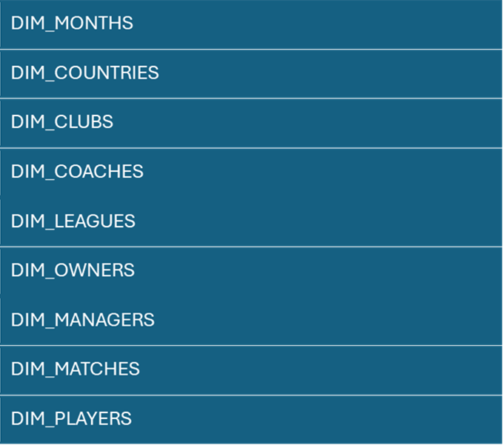
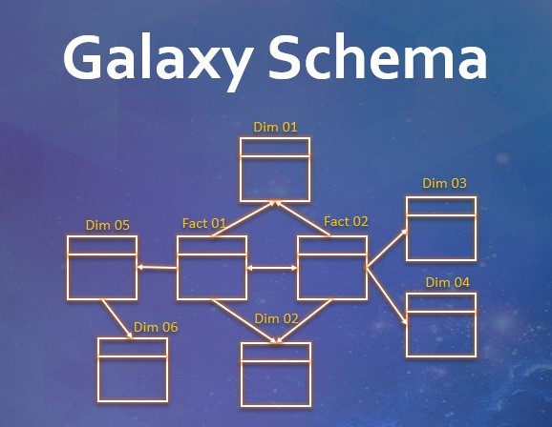
Fact Table
PLAYER_PERFORMANCE_FACT
MATCH_PERFORMANCE_FACT

Slide 9

AWS
Amazon Web Services (AWS) is a comprehensive and widely adopted cloud platform that offers a vast array of on-demand cloud computing services, such as computing power, storage, and databases, designed to help businesses scale and grow.
It provides highly reliable, scalable, and low-cost infrastructure services that can be used to store, process, and analyze massive amounts of data.

Slide 10

Databricks
Databricks is a unified analytics platform that enables data engineering, data science, and machine learning at scale, built on top of Apache Spark.
It provides an interactive workspace for collaboration between data engineers, data scientists, and analysts, making it easier to work with big data and AI models in the cloud.

Slide 11
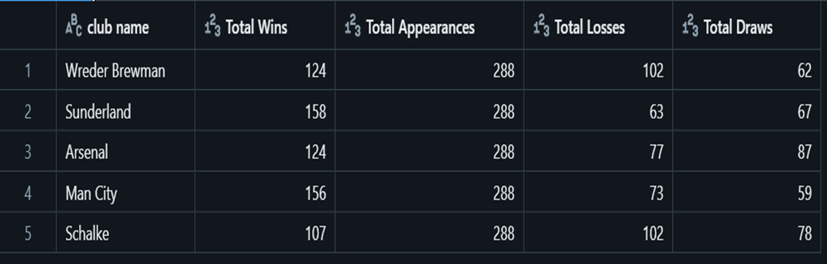
Club report (Total Wins , Total Appearances ,Total Losses ,Total Draws) League and Competition Insights Ownership and Sponsorship

Slide 12
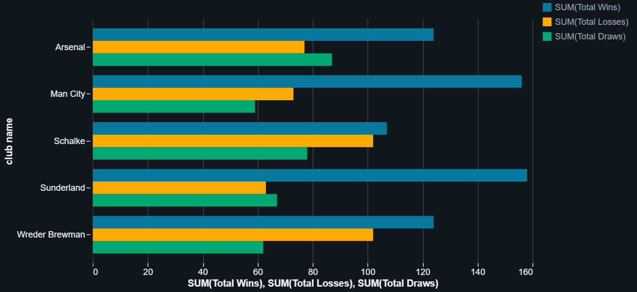
Club report (Total Wins , Total Appearances ,Total Losses ,Total Draws) League and Competition Insights Ownership and Sponsorship

Slide 13
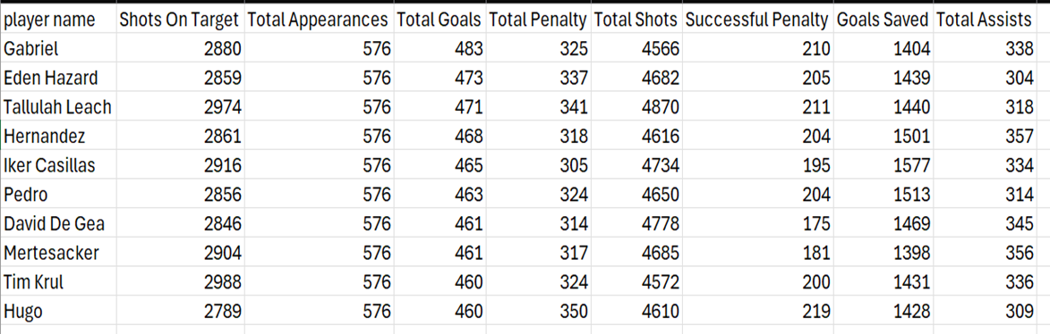
Player performance analysis Identify Top Players by Goals and Assists(Helpful for football clubs) Populating Sports websites

Slide 14
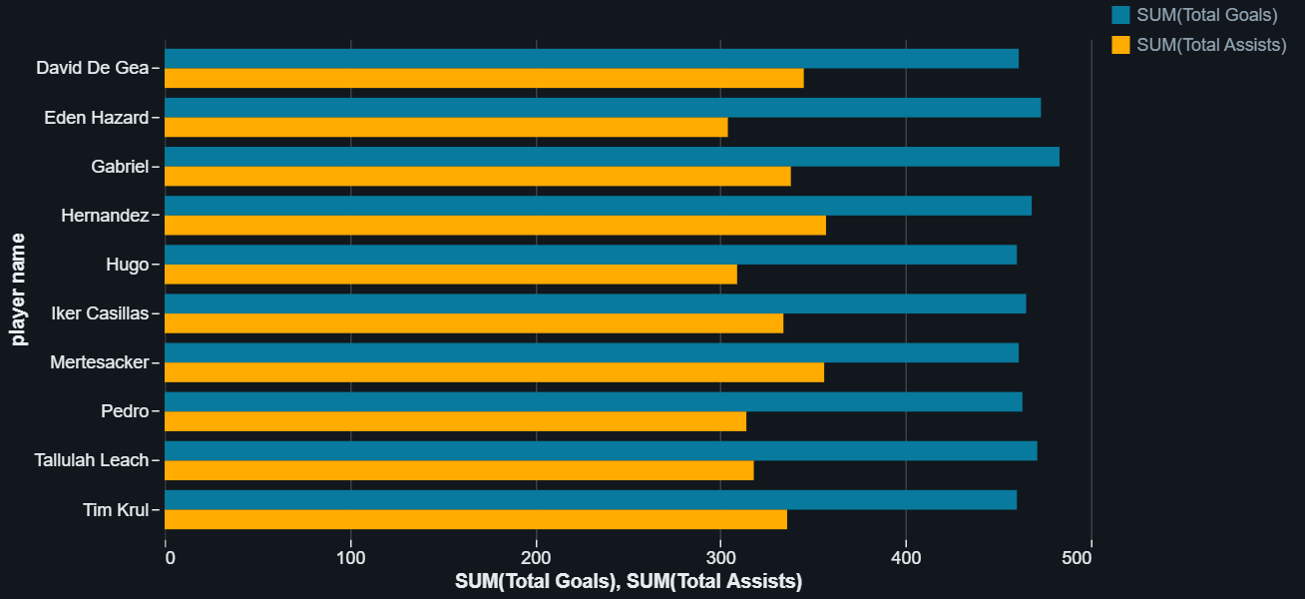
Player performance analysis Identify Top Players by Goals and Assists(Helpful for football clubs) Populating Sports websites

Slide 15
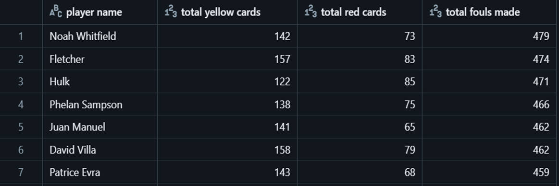
Player Injury & Suspension Analysis Helpful for club Helpful for sports website

Slide 16
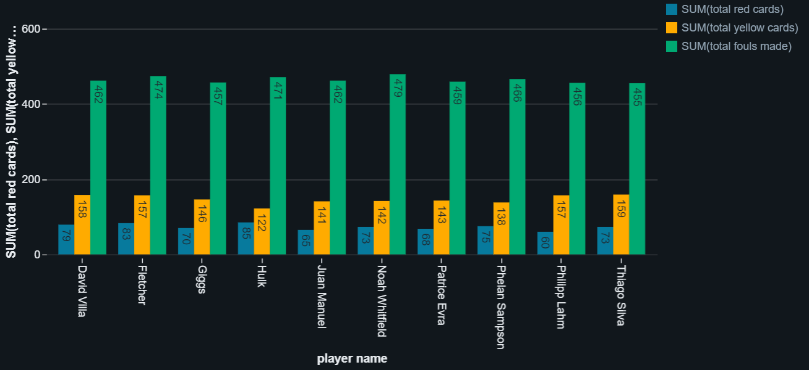
Player Injury & Suspension Analysis Helpful for club Helpful for sports website

Slide 17
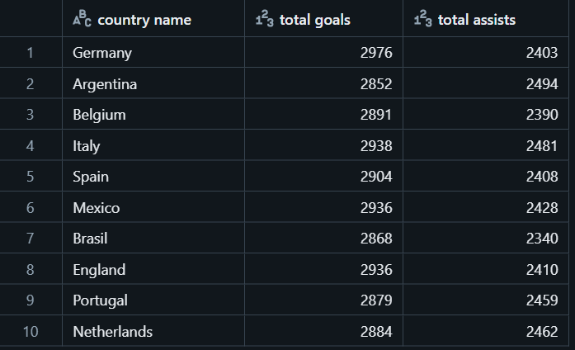
Country-Specific Performance Insights Scouting project insights

Slide 18
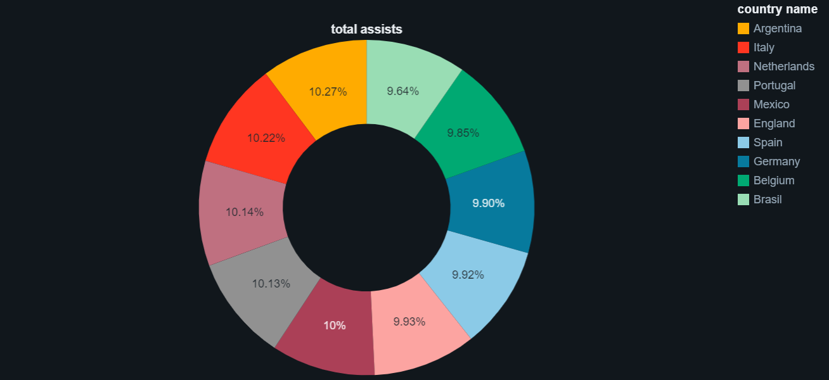
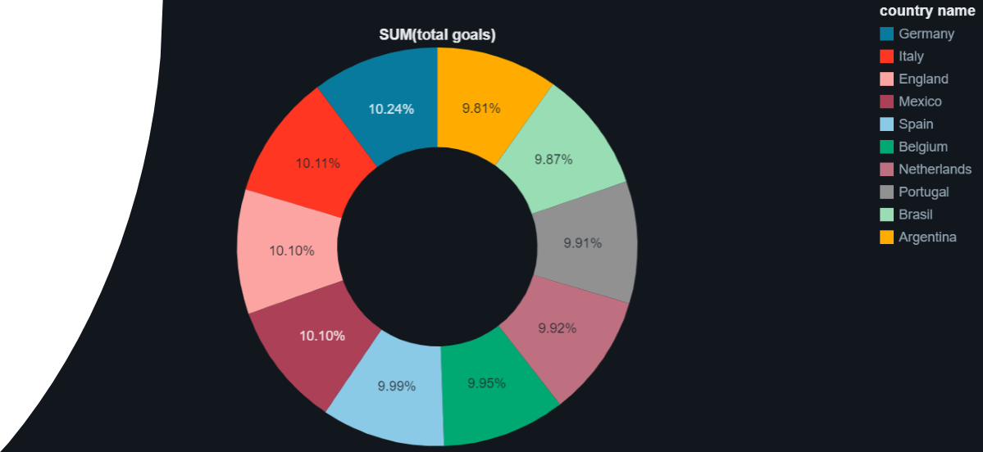
Country-Specific Performance Insights Scouting project insights

Slide 19
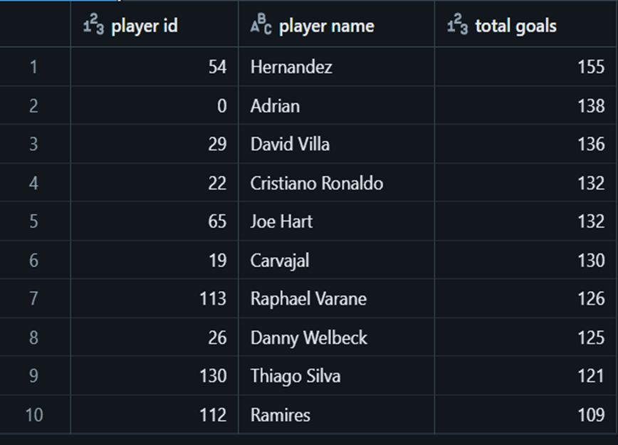
find top goal scorers of a specific year Sports website data

Slide 20
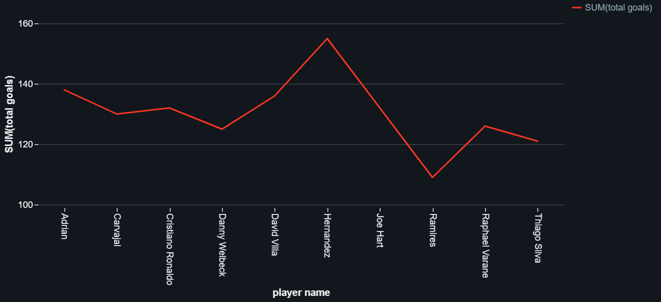
find top goal scorers of a specific year Sports website data

Slide 21
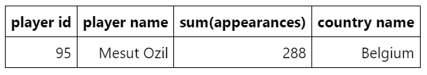
Find who has maximum appearances in International matches Brand Ambassadorship & Endorsements Personal Brand Influence and Reach

Slide 22



Cristiano Ronaldo as an Ambassador

Slide 23
Time for Live Demonstration !!
Now we will move towards the live demo of our end to end project in databricks.

Slide 24

Dashboard Overview
Club Report
Injury and & Suspension Analysis

Slide 25

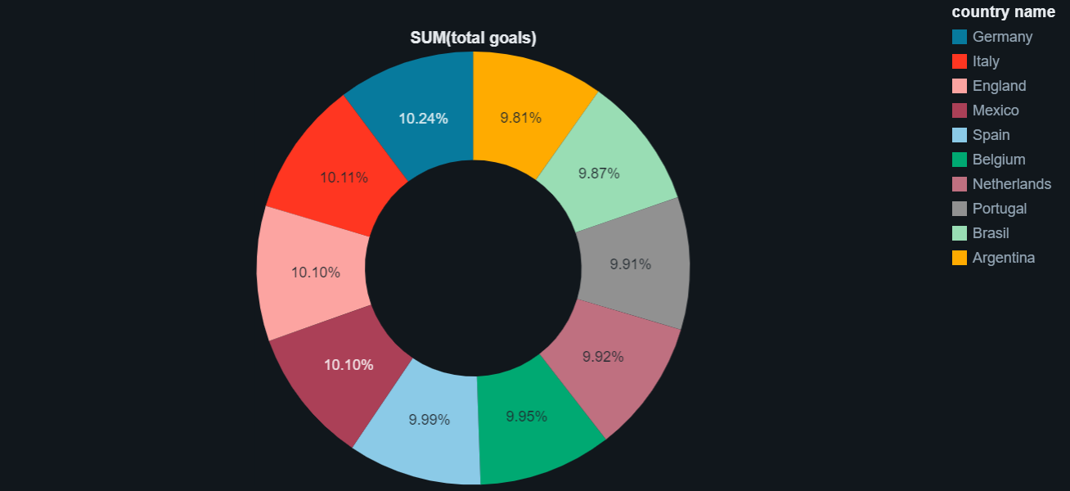
Dashboard Overview
Country-Specific Performance Insights
(Goals and Assists)

Slide 26

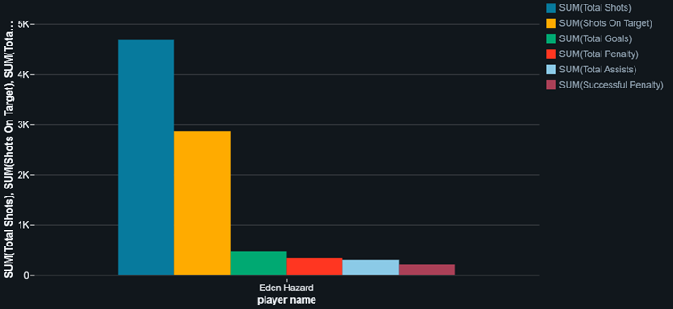
Dashboard Overview
Top 10 goal scorer of 2010
Individual player performance

Slide 27
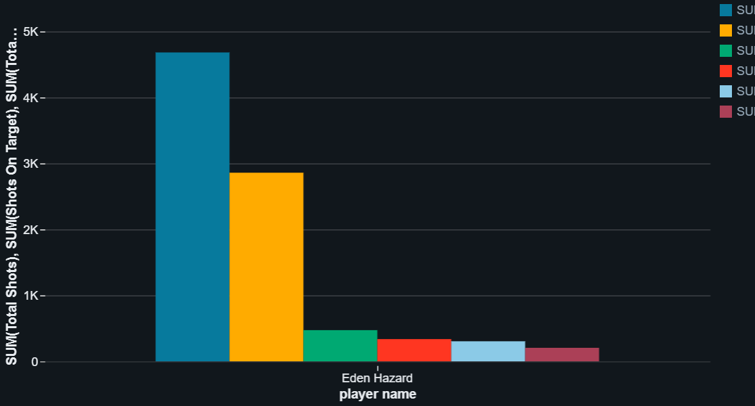
All Dashboards of the business values:-

Slide 28
Conclusion
Value of Advanced Analytics and Cloud-Based Tools
Pathways for Data-Driven Innovation
Future Strategic Advancements

Slide 29

ANY QUESTION?

Slide 30


